Slide 1


Introduction to Artificial Intelligence
Book: Artificial Intelligence, A Modern Approach (Russell & Norvig)
Ybralem B.

Slide 2


Chapter Four
Knowledge and Reasoning

Slide 3
Chapter contents: Knowledge Representation and Reasoning
Logical Agents
Knowledge Representation
Knowledge-based Systems
  Propositional Logic
  Predicate (First-Order) Logic
    Inference in First-Order Logic

Slide 4

ΑΙ and KR
A description of Artificial Intelligence is:
  The study and development of systems that demonstrate intelligent behavior
Based on the above, a description of Knowledge Representation & Reasoning is:
  The study of ways to represent and reason with information in order to achieve intelligent behavior
KR&R is the part of AI that is concerned with thinking and how thinking contributes to intelligent behavior

Slide 5
Knowledge Representation and Reasoning
KR suggests an approach to understanding intelligent behavior that is radically different
  Instead of studying humans very carefully (biology, nervous systems, psychology, sociology, etc.), it argues that what we need to study is what humans know.
  It is taken as a given that what allows humans to behave intelligently is that they can know “things” and “reason”
KR&R focuses on the knowledge, not on the knower.
We ask what any agent(human, animal, electronic, mechanical) would need to know to behave intelligently, and what sorts of computational mechanisms might allow its knowledge to be manipulated.

Slide 6
Knowledge
facts, information, and skills acquired through experience or education; the theoretical or practical understanding of a domain.
Observe that when we say something like “John knows that …,” we fill in the blank with a simple
  “John knows that Mary will come to the party,”
  “John knows that Spain won the Euro”
Among other things, knowledge is a relation between a knower and a proposition
  knower : John
  proposition: the idea expressed by a simple declarative sentence, like “Mary will come to the party.”
    can be true or false, right or wrong

Slide 7
Representation
Is a relationship between two domains, where the first is meant to “stand for” or take the place of the second.
  Usually, the first domain, the representor, is more concrete, immediate, or accessible in some way than the second.
    an elected member of parliament might stand for his or her constituency
Knowledge representation, then, is the field of study concerned with using formal symbols to represent a collection of propositions believed by some agent.

Slide 8
Reasoning
In general, it is the formal manipulation of the symbols representing a collection of believed propositions to produce representations of new ones.
  We might start with the sentences “John loves Mary” and “Mary is coming to the party” and after a certain amount of manipulation produce the sentence, “Someone John loves is coming to the party.”
  We would call this form of reasoning logical inference because the final sentence represents a logical conclusion of the propositions represented by the initial ones.
Reasoning is a form of calculation, not unlike arithmetic, but over symbols standing for propositions rather than numbers.

Slide 9
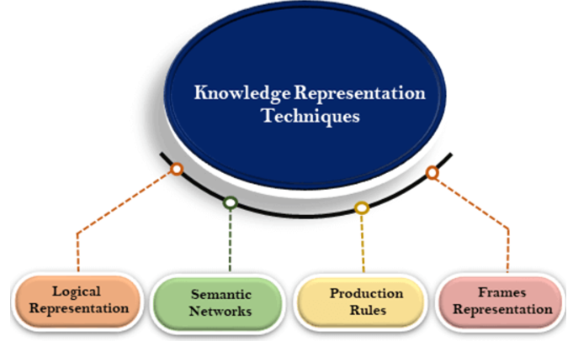
How can knowledge be represented ?
Logical Representation
Uses formal logic (propositional or predicate logic) to represent knowledge. Provides a clear syntax and semantics.
Example: Propositional Logic: P∧Q→R
Predicate Logic: ∀x(Human(x)→Mortal(x)) #For all x, if x is a human, then x is mortal.
Semantic Network Representation
A semantic network is labeled direct graph, where concepts are represented as nodes, relationships between concepts as edges(links) and associations are labels.

Slide 10
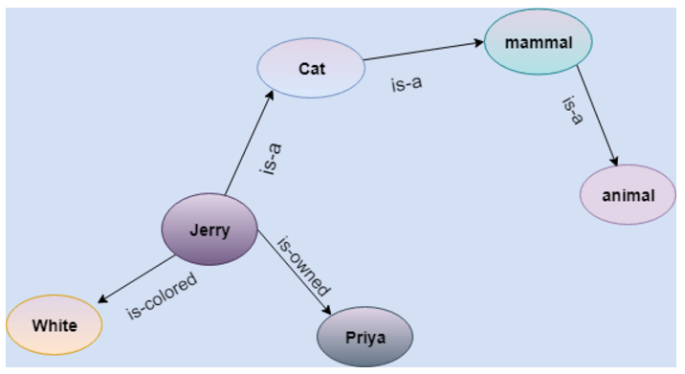
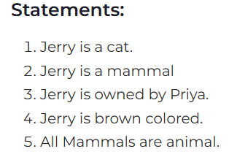
How can knowledge be represented ?

Slide 11
How can knowledge be represented ?
Frame Representation
Frames represent knowledge in structured “frames” or templates, each containing information about an object or situation.
Each frame holds slots that store attributes or related information.
Slots also have components like facet which hold additional information(like type, range, default value..), procedure which describe how the information processed
Frames are effective for representing structured, hierarchical knowledge and allow easy modification or extension of attributes. But limited flexibility when dealing with highly dynamic or unpredictable information.
Production Rules
Represent knowledge as a set of condition-action rules (if-then rules).
Common in expert systems and decision-making applications.
production rules are effective in systems that need to apply a set of predefined rules for decision-making.
Can lead to rule conflicts and may become unmanageable in large systems with numerous rules.
  If the temperature is above 30°C, then turn on the air conditioning” # it can guide the behavior of a thermostat system.
Logical representations are great for formal reasoning, while semantic networks and frames excel at representing relationships and structured information.

Slide 12
Basic Idea of Logic
Logic can be defined as the proof or validation behind any reason provided.
It was important to include logic in Artificial Intelligence because we want our agent (system) to think and act humanly, and for doing so, it should be capable of taking any decision based on the current situation.
An intelligent agent needs knowledge about the real world to make decisions and reasoning to act efficiently.
Knowledge-based agents are those agents who have the capability of maintaining an internal state of knowledge, reason over that knowledge, update their knowledge after observations and take actions.

Slide 13
Knowledge-Based Agents
Central component of a Knowledge-Based Agent is a Knowledge-Base (KB). It is a set of sentences in a formal language
Sentences are expressed using a knowledge representation language
KB is required for updating knowledge for an agent to learn with experiences and take action as per the knowledge.
Inference Engine(IE): It is knowledge-based system engine used to infer new knowledge in the system. An inference system works mainly in two rules which are given:
  Forward chaining
  Backward chaining
Two generic functions:
  TELL - add new sentences (facts) to the KB “Tell it what it needs to know”
  ASK - query what is known from the KB “Ask what to do next”

Slide 14
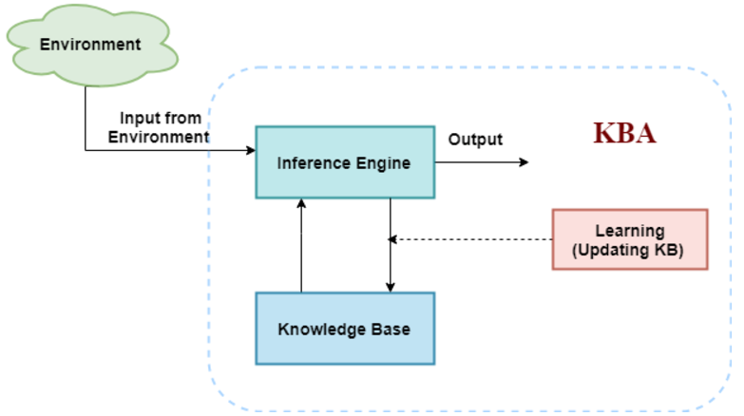
Knowledge based agent(KBA)
The below diagram represents generalized architecture of a knowledge-based agent.
KBA take input from the environment by perceiving the environment. The input is taken by the inference engine of the agent and which also communicate with KB to decide as per the knowledge store in KB.
The learning element of KBA regularly updates the KB by learning new knowledge.

Slide 15
Knowledge-Based Agents
Declarative
  Knowledge about facts and information, Helps the agent describe the state of the world or domain.
  You can build a knowledge-based agent simply by “TELLing” it what it needs to know
Procedural
  Knowledge about how to do things or perform actions, guides the agent's actions based on its goals.
  Simple world example:
  Wumpus World

Slide 16
Logical Representation
It is a language with some concrete rules which deals with propositions & has no ambiguity in representation
It consists of precisely defines Syntax and Semantics .
each sentence can be translated into logics using syntax and semantics.
  Syntax: defines well- formed sentence in the language
  Semantics: defines the truth or meaning of sentence in world

Slide 17
Logical Representation
Can be explained by:
  Propositional logic
  Predicate logic

Slide 18
Propositional Logic (PL)
Is the simplest logic
Declarative statement, either it can be true or false.
It is a technique of knowledge representation in logical and mathematical form.
Syntax
    Propositions, e.g. “it is wet”
    Logical Connectives: and (conjuction), or(disjunction), not (negation), implies (implication), iff (biconditional)
    Brackets, T (true) and F (false)
Semantics
  Define how connectives affect truth
      “P and Q” is true if and only if P is true and Q is true
  Use truth tables to work out the truth of statements
  True is the always-true proposition and False is the always-false proposition. Complex sentences are constructed from simpler sentences, using parentheses and logical connectives. There are five connectives in common use:

Slide 19
Logical connectives
Logical connectives are used to connect two simpler propositions or representing a sentence logically.
Negation: A sentence such as ¬ P is called negation of P. A literal can be either Positive literal or negative literal.
Conjunction: A sentence which has ∧ connective such as, P ∧ Q is called a conjunction.
Example: Rohan is intelligent and hardworking. It can be written as,
P= Rohan is intelligent,
Q= Rohan is hardworking. → P∧ Q.
Disjunction: A sentence which has ∨ connective, such as P ∨ Q. is called disjunction, where P and Q are the propositions.
Example: "Ritika is a doctor or Engineer",
Here P= Ritika is Doctor. Q= Ritika is Engineer, so we can write it as P ∨ Q.
Implication: A sentence such as P → Q, is called an implication. Implications are also known as if-then rules. It can be represented as
If it is raining, then the street is wet.
Let P= It is raining, and Q= Street is wet, so it is represented as P → Q
Biconditional: A sentence such as P⇔ Q is a Biconditional sentence, example If I am breathing, then I am alive
P= I am breathing, Q= I am alive, it can be represented as P ⇔ Q.

Slide 20
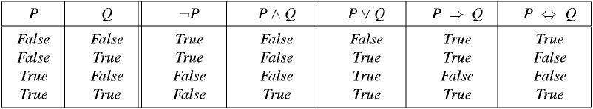
…continued
Truth Table
E.g.
  P – It is hot
  Q – It is humid
  R – It is raining
Conditions
  If it is humid, then it is hot
  If it is hot and humid then it is not raining
Q→P
(P Ʌ Q) → ¬R

Slide 21
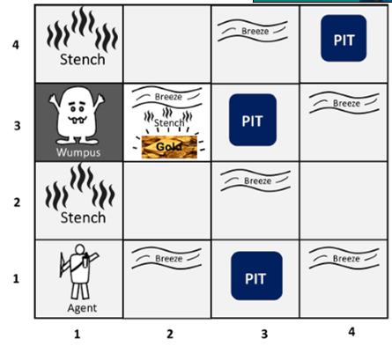
WUMPUS World
Performance Measure
  Gold +1000, Death – 1000
  Step -1, Use arrow -10
  The game ends if either agent dies or came out of the cave.
Environment
  Square adjacent to the Wumpus are smelly(stench)
  Squares adjacent to the pit are breezy
  Glitter iff gold is in the same square
  Shooting kills Wumpus if you are facing it
  Shooting uses up the only arrow
  Grabbing picks up the gold if in the same square
  Releasing drops the gold in the same square
Actuators
  Left turn, right turn, forward, grab, release, shoot
Sensors
– stench, Breeze, glitter, bump and scream.
PEAS description of Wumpus world

Slide 22
Wumpus World PEAS description
Fully Observable No – only local perception
Deterministic Yes – outcomes exactly specified
Episodic No – sequential at the level of actions
Static Yes – Wumpus and Pits do not move
Discrete Yes
Single-agent? Yes – Wumpus is essentially a natural feature

Slide 23
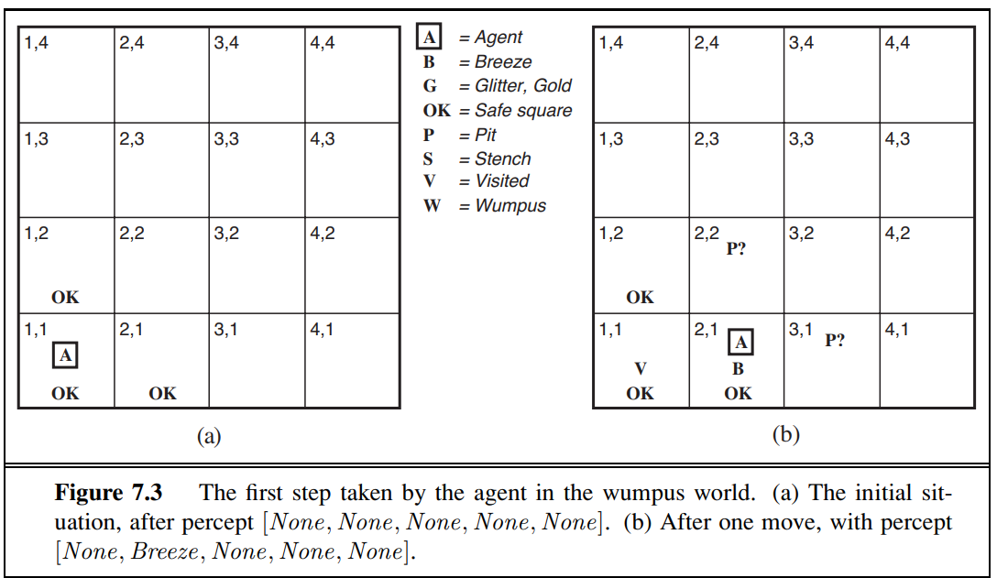
Exploring the Wumpus World
EThe KB initially contains the rules of the environment.
[1,1] The first percept is [none, none, none, none, none], from which the agent can conclude that its neighboring squares, [1,2] and [2,1], are free of dangers—they are OK.
Let us suppose the agent decided to move to [2,1] then sense Breeze indicates that there is a pit in [2,2] or [3,1] Return to [1,1] to try next safe cell

Slide 24
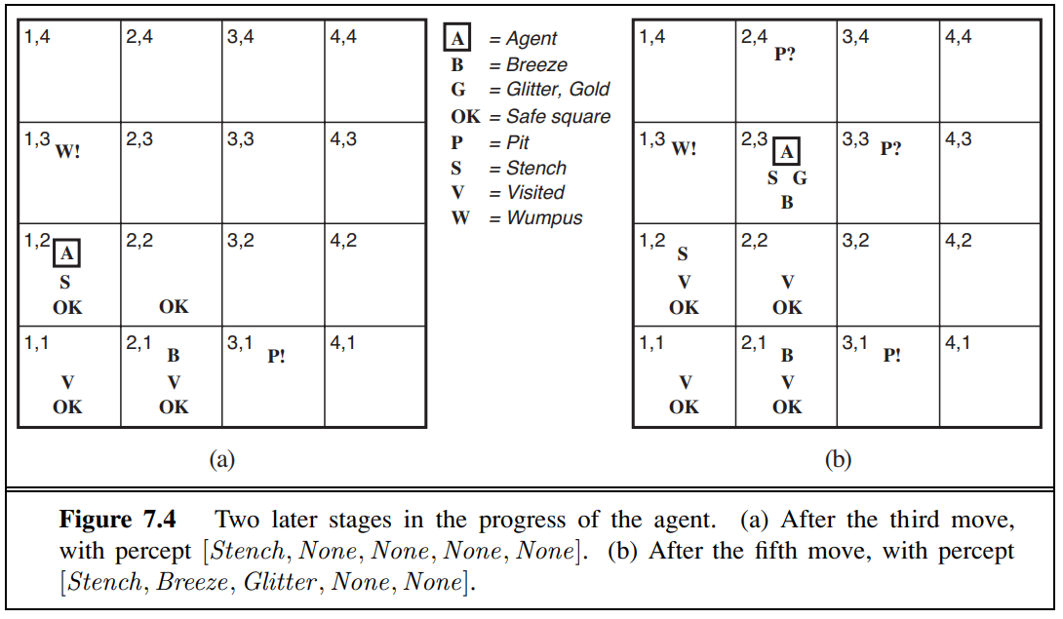
…
[1,2] smells Stench in cell: Wumpus is in [1,3] or [2,2] YET … not in [1,1] by the rule of the game. , and it cannot be in [2,2] (or the agent would have detected a stench when it was in [2,1]).
Therefore, the agent can infer that the Wumpus is in [1,3]. The notation W! indicates this inference. Moreover, the lack of a breeze in [1,2] implies that there is no pit in [2,2]. Yet the agent has already inferred that there must be a pit in either [2,2] or [3,1], so this means it must be in [3,1].
This is a fairly difficult inference, because it combines knowledge gained at different times in different places and relies on the lack of a percept to make one crucial step.

Slide 25
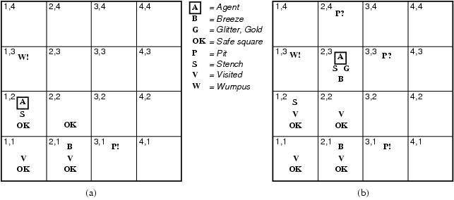
…..
[2,2] Detect nothing
Move to unvisited safe cell e.g. [2,3]
[2,3] Detect glitter , smell, breeze
Thus… pick up gold
Thus… pit in [3,3] or [2,4]
By using logical representation and inference, the agent can reason about the environment, make informed decisions, and achieve its goal of collecting the gold while avoiding dangers in the Wumpus World.

Slide 26
Wumpus world
¬ (not). A sentence such as ¬W1,3 is called the negation of W1,3.
∧ (and). A sentence whose main connective is ∧, such as W1,3 ∧ P3,1, is called conjunction; its parts are the conjuncts. (The ∧ looks like an “A” for “And.”)
∨ (or). A sentence using ∨, such as (W1,3∧P3,1) ∨ W2,2, is a disjunction of the disjuncts (W1,3 ∧ P3,1) and W2,2. (Historically, the ∨ comes from the Latin “vel,” which means “or.” For most people, it is easier to remember ∨ as an upside-down ∧.)
⇒ (implies). A sentence such as (W1,3∧P3,1) ⇒ ¬W2,2 is called an implication (or conditional). Its premise or antecedent is (W1,3 ∧P3,1), and its conclusion or consequent is ¬W2,2. Implications are also known as rules or if–then statements. The implication RULES symbol is sometimes written in other books as ⊃ or →.
⇔ (if and only if). The sentence W1,3 ⇔ ¬W2,2 is a biconditional. Some other books write this as ≡.

Slide 27
Lecture 2

Slide 28
First Order Predicate Logic
FOL is another way of knowledge representation in A I
It is an extension to PL( Propositional Logic)
It is a powerful language that develops information about the object in a more easy way and can also express the relationship between those objects
FOL doesn’t only assume that the world contains facts like PL but also assume
  Objects
  Relations
  Quantifiers

Slide 29
…continued
As a natural language, first-order logic also has two main parts:
  Syntax
  Semantics
The syntax of FOL determines which collection of symbols is a logical expression in first-order logic.
The basic syntactic elements of FOL are symbols.

Slide 30
First Order Logic
More expressive logic than propositional
Constants are objects: john, apples
Predicates are properties and relations:
  likes(john, apples)
Functions transform objects:
  likes(john, fruit_of(apple_tree))
Variables represent any object: likes(X, apples)
Quantifiers qualify values of variables
  True for all objects (Universal): ∀X. likes(X, apples)
  Exists at least one object (Existential): ∃X. likes(X, apples)

Slide 31
…
Constant | 1, 2, A, John, Addisababa, cat,....
Variables | x, y, z, a, b,....
Predicates | Brother, Father, >,....
Function | sqrt, LeftLegOf, ....
Connectives | ∧, ∨, ¬, ⇒, ⇔
Equality | ==
Quantifier | ∀, ∃
Basic Elements of First-order logic

Slide 32
…
Sentence in FOL can be
  Atomic or
  Complex
Atomic Sentences:
  are most basic sentences of FOL
  Formed from a predicate symbol followed by a parenthesis with a sequence of terms.
  We can represent atomic sentences as Predicate (term1, term2, ...., term n).
  Example:
    John and David are brothers: => Brothers(John, David).
    Jack is a dog: => dog(Jack).

Slide 33
…
Complex Sentences: are made by combining atomic sentences using connectives.
Example:
  John is a student and Mary is a teacher: Student(John)∧Teacher(Mary)
  John is a student or Mary is a teacher: Student(John)∨Teacher(Mary)
  If John is a student, then he studies: Student(John)→Studies(John)
Universal Quantification:
  All humans are mortal: ∀x(Human(x)→Mortal(x))
  There exists someone who is a teacher: ∃x Teacher(x)
  All humans are mortal, and there exists someone who is a human:
    (∀x(Human(x)→Mortal(x)))∧(∃y Human(y))

Slide 34
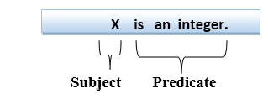
…
First-order logic statements can be divided into two parts:
  Subject:
    Subject is the main part of the statement.
  Predicate:
    A predicate can be defined as a relation, which binds two atoms together in a statement.
  Example

Slide 35
Quantifiers in First-order logic:
A quantifier is a language element which generates quantification, and
quantification specifies the quantity of specimen in the universe of discourse.
These are the symbols that permit to determine or identify the range and scope of the variable in the logical expression.
There are two types of quantifier:
  Universal Quantifier, (for all, everyone, everything)
  Existential quantifier, (for some, at least one).

Slide 36
Quantifiers in First-order logic:
Universal quantifier
  is a symbol of logical representation, which specifies that the statement within its range is true for everything or every instance of a particular thing.
  is represented by a symbol ∀, which resembles an inverted A.
  In universal quantifier we use implication " ⇒ "
  If x is a variable, then ∀x is read as:
    For all x
    For each x
    For every x.
  Example: All man drink coffee.
    Let a variable x which refers to a man so all x can be represented in: ∀x man(x) → drink (x, coffee).
    It will be read as: There are all x where x is a man who drink coffee.

Slide 37
Quantifiers in First-order logic:
Existential quantifiers
  are the type of quantifiers, which express that the statement within its scope is true for at least one instance of something.
  It is denoted by the logical operator ∃, which resembles as inverted E.
  In Existential quantifier we always use AND or Conjunction symbol (∧).
  If x is a variable, then existential quantifier will be ∃x or ∃(x). And it will be read as:
    There exists a 'x.'
    For some 'x.'
    For at least one 'x.‘
  Example: Some boys are intelligent.
    ∃x: boys(x) ∧ intelligent(x)
    It will be read as: There is some x where x is a boy who is intelligent.

Slide 38
Some Examples of FOL using quantifier:
  All birds fly.
  the predicate is "fly(bird)."
  And since there are all birds who fly so it will be represented as follows.
  ∀x bird(x) →fly(x).
  Every man respects his parent.
  the predicate is "respect(x, y)," where x=man, and y= parent.
  Since there is every man so will use ∀, and it will be represented as follows:
  ∀x man(x) → respects (x, parent).
  Some boys play football.
  the predicate is "play(x, y)," where x= boys, and y= game. Since there are some boys so we will use ∃, and it will be represented as:
  ∃x boys(x) ∧ play(x, football).
  Not all students like both Mathematics and Science.
  the predicate is "like(x, y)," where x= student, and y= subject.
  Since there are not all students, so we will use ∀ with negation, so following representation for this:
  ¬∀ (x) [ student(x) → like(x, Mathematics) ∧ like(x, Science)].

Slide 39
Inference in FOL
Inference in FOL is used to deduce new facts or sentences from existing sentences
Terminologies:
Substitution: Substitution is the process of replacing variables in formulas or terms with constants, other variables, or terms. This operation is essential for instantiating variables and making logical arguments specific.
  is a fundamental operation performed on terms and formulas. It occurs in all inference systems in first-order logic.
  The substitution is complex in the presence of quantifiers in FOL.
  If we write F[a/x], so it refers to substitute a constant "a" in place of variable "x“
Example: Original Formula: F(x)=Loves(x, Mary)
Substitution: F[John/x]=Loves(John, Mary)

Slide 40
Inference in FOL
Equality:
  FOL does not only use predicate and terms for making atomic sentences but also uses another way, which is equality in FOL.
  For this, we can use equality symbols which specify that the two terms refer to the same object.
  It allows reasoning about object identity or non-identity.
  Example: Brother (John) = Smith.
    As in the above example, the object referred by the Brother (John) is similar to the object referred by Smith.
    The equality symbol can also be used with negation to represent that two terms are not the same objects.
      Example: ￢(x=y) which is equivalent to x ≠y.
Properties: Reflexivity: x=x
Symmetry: If x=y, then y=x
Transitivity: If x=y and y=z, then x=z.
Substitution : If x=y, then any formula F(x) is logically equivalent to F(y).
      Substitution allows for the instantiation of variables with specific values, while equality enables reasoning about the identity or non-identity of objects represented by terms.
      Some of the Inference use substitution and equality are Modus Ponens and Unification.

Slide 41
FOL inference rules for quantifier:
basic inference rules in FOL are:
  Universal Generalization
  Universal Instantiation
  Existential Instantiation
  Existential introduction

Slide 42

…continued
Universal Generalization:
  is a valid inference rule which states that if premise P(c) is true for any arbitrary element c in the universe of discourse, then we can have a conclusion as ∀ x P(x).
  It can be represented as:
  This rule can be used if we want to show that every element has a similar property.
  Example:
    Let's represent, P(c): "A byte contains 8 bits", so for ∀ x P(x) "All bytes contain 8 bits.", it will also be true.

Slide 43

…continued
Universal Instantiation:
  is also called as universal elimination or UI is a valid inference rule.
  It can be applied multiple times to add new sentences.
  The new KB is logically equivalent to the previous KB.
  As per UI, we can infer any sentence obtained by substituting a ground term for the variable.
  The UI rule state that we can infer any sentence P(c) by substituting a ground term c (a constant within domain x) from ∀ x P(x) for any object in the universe of discourse.
  It can be represented as:
  Example:1.
    IF "Every person like ice-cream"=> ∀x P(x) so we can infer that, "John likes ice-cream" => P(c)

Slide 44

…continued
Existential Instantiation:
  is also called as Existential Elimination, which is a valid inference rule in FOL.
  It can be applied only once to replace the existential sentence.
  The new KB is not logically equivalent to old KB, but it will be satisfiable if old KB was satisfiable.
  This rule states that one can infer P(c) from the formula given in the form of ∃x P(x) for a new constant symbol c.
  The restriction with this rule is that c used in the rule must be a new term for which P(c ) is true.
  It can be represented as:
  Example:
    ∃x 𝐿𝑜𝑣𝑒𝑠(x, Alice) #There exists someone who loves Alice (∃x P(x) )
    After Existential Instantiation:
      Introduce a new constant c, which is p(c): Loves(John, Alice) Here, c is replaced with John, and we infer that John loves Alice.
      (The choice of John is arbitrary, but c must not appear elsewhere in the KB.)

Slide 45

…continued
Existential introduction
  An existential introduction is also known as an existential generalization, which is a valid inference rule in first-order logic.
  This rule states that if there is some element c in the universe of discourse which has a property P, then we can infer that there exists something in the universe which has the property P.
  It can be represented as:
  Example: Let's say that, “John got good marks in English."
    "Therefore, someone got good marks in English."

Slide 46
Thank you!

